Slide 1

Inteligent Consultation Assistant ICA
Miguel Navarro
Antonin Lenfant

Slide 2

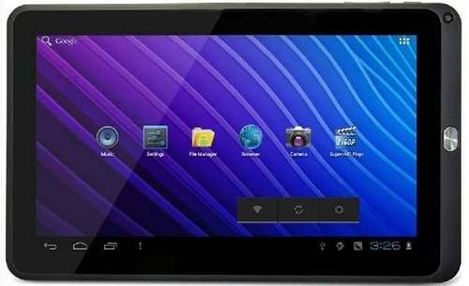


Introduction
State of Art
Development
Navigation
Goal
REC
Registre Éléctronique
De Consultation
ICA
Intelligent Consultation
Assistant

Slide 3



OS choice
State of Art
Development
Navigation
Goal
Why Android?
Open Source Propietary System

Slide 4
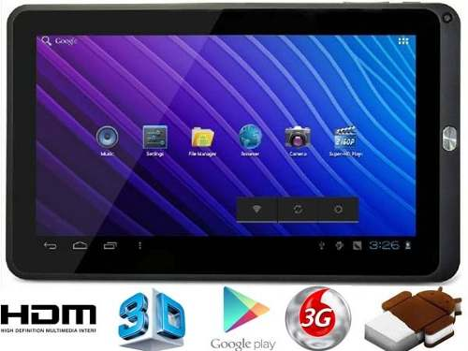

OS choice
State of Art
Development
Navigation
Goal
Equipment Price
Android iOS
< 150 € ~400 €

Slide 5
OS choice
State of Art
Development
Navigation
Goal
Equipment Price
Android Ubuntu
< 150 € ~220 €

Slide 6
WebApp / Native App
State of Art
Development
Navigation
Goal
Native App
+ Complete Control of system features
+ More Efficient
x Just works in one OS
WebApp
+ Works in any OS over a browser
+ Needs net connection
x Can’t use all system elements

Slide 7




Environment
State of Art
Development
Navigation
Goal
Original Database
SQLite
Adapted Database SQLite
For Android

Slide 8
System Diagram
State of Art
Development
Navigation
Goal
Login
Initialization?
Main Menu
Edit Users
Exists? New Patient?
Search Patients
Change Attributes
New Diagnostic
See Last Diagnostic

Slide 9
System Sizes
State of Art
Development
Navigation
Goal
Size APK file:
2.62 MB
Size database empty created:
688 KB
Size of previous Application
58.32 MB

Slide 10
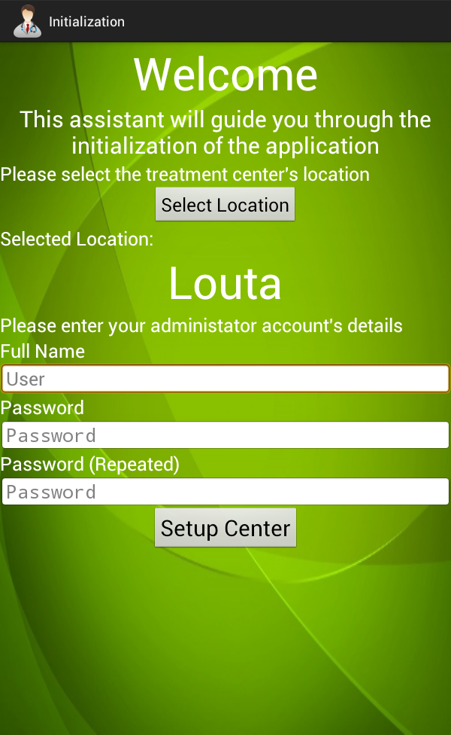
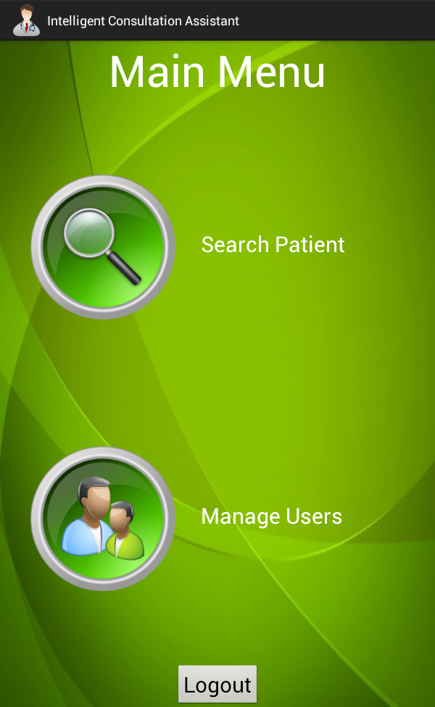
Navigation Diagram
Goal
Development
Navigation
State of Art

Slide 11
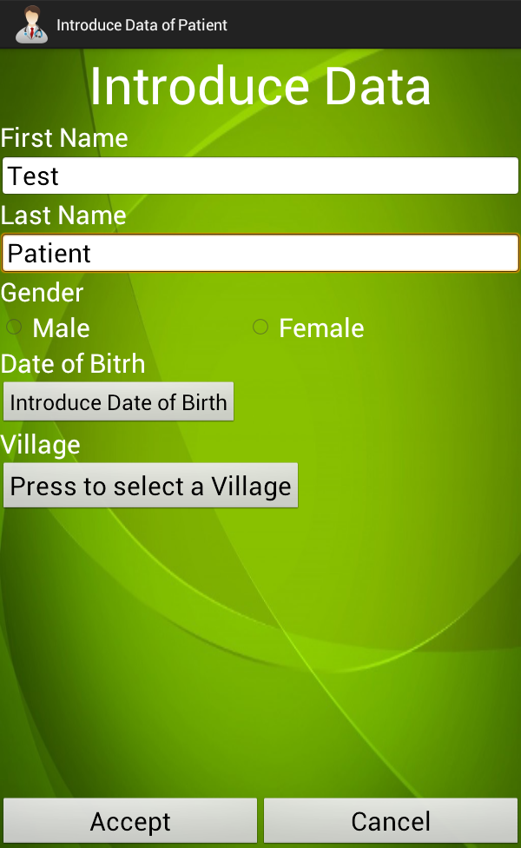
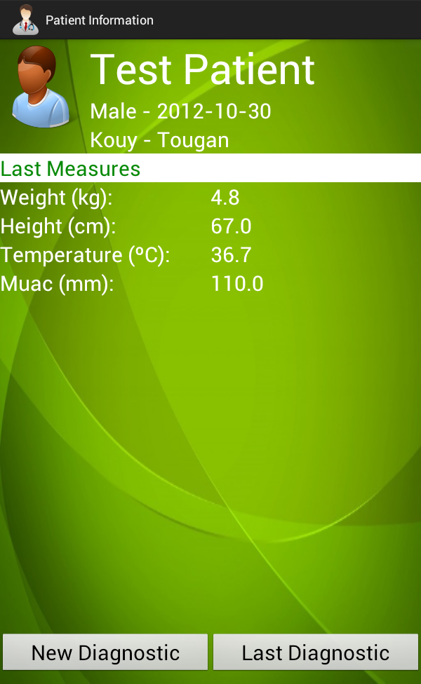
Navigation Diagram
Goal
Development
Navigation
State of Art

Slide 12
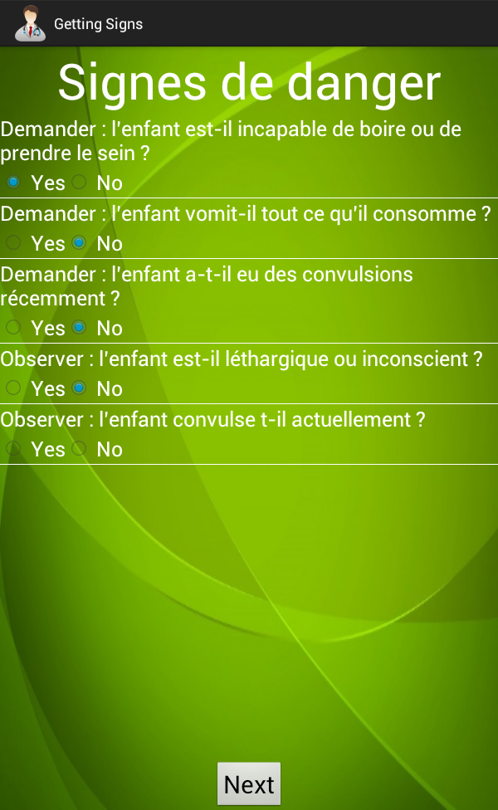
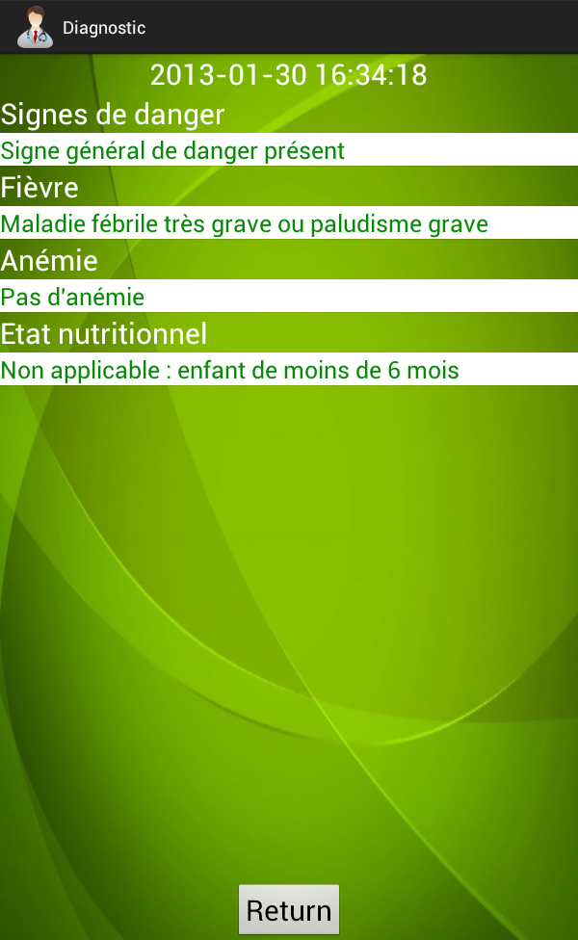
Navigation Diagram
Goal
Development
Navigation
State of Art

Slide 13
Test Time
THANKS!
MERCI!

